Slide 1
Business Demand Overview- User Stories
PresentED BY - Bhawya Kumar

Slide 2
BUSINESS CONTEXT
An E-commerce company has approached AnalytixLabs to partner in developing dashboards that cater to different business perspectives. The objective is to enable data-driven decision-making across various sales roles by creating role-specific dashboards that address their operational needs and help them track, monitor, and optimize sales activities effectively.

Slide 3
PROBLEM STATEMENT
The client wants to enhance visibility into their online sales operations by identifying valuable customers, top-performing products, and evaluating budget effectiveness.
Key focus areas
To get overall top sales performance
Detailed overview of internet sales per customer
Detailed overview of sales per product
Comparison of sales vs budget to evaluate financial efficiency

Slide 4
TECHNOLOGY STACK:
Technologies that can be used are:
SQL: To import, store and clean data
Excel/SQL: For Data Analysis
Power Bi – For Data Visualization & Reporting
Technologies I want to use:
SQL: As it allows efficient data manipulation, filtering, aggregating, and joining data
Power Bi: It offers powerful visual and analytical capabilities. Which is useful for making interactive dashboards and reports

Slide 5
AVAILABLE DATA(1/2)
The data has been provided for two years i.e. from Jan 2019 to Jan 2021 and is structured across five tables
FACT INTERNET SALES | Rows – 58168, Columns - 7
Column Name | Data Type
ProductKey | Smallint
OrderDateKey | Date
DueDateKey | Date
ShipDateKey | Date
CustomerKey | Smallint
SalesOrderNumber | Nvarchar
SalesAmount | float
DIM Customer | Rows – 18484, Columns -7
Column Name | Data Type
CustomerKey | Smallint
First Name | Nvarchar
Last Name | Nvarchar
Full Name | Nvarchar
Gender | Nvarchar
DateFirstPurchase | Date
Customer City | Nvarchar

Slide 6
AVAILABLE DATA(2/2)
DIM PRODUCT | Rows – 606 Columns - 11
Column Name | Data Type
ProductKey | Smallint
ProductItemCode | Nvarchar
Product Name | Nvarchar
Sub Category | Nvarchar
Product Category | Nvarchar
Product Color | Nvarchar
Product Size | Nvarchar
Product Line | Nvarchar
Product Model Name | Nvarchar
Product Description | Nvarchar
Product Status | Nvarchar
DIM CALENDER | Rows – 1096 Columns - 8
Column Name | Data Type
DateKey | date
Date | date
Day | nvarchar
Month | Nvarchar
MonthShort | nvarchar
MonthNo | tinyint
Quarter | tinyint
Year | Smallint
DIM BUDGET | Rows – 18 Columns - 2
Column Name | Data Type
Date | DateTime
Budget | Money

Slide 7
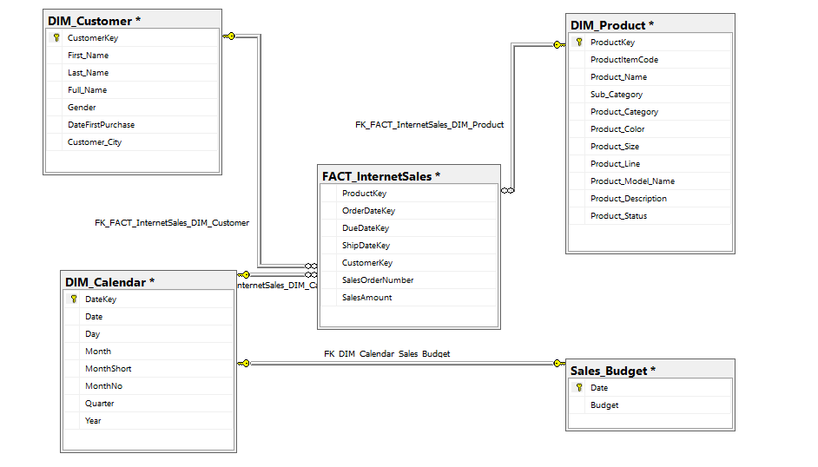
ENTITY RELATIONSHIP DIAGRAM

Slide 8
LIST OF DATA CHECKS
Duplicate data check in all tables
Null value checks
Data Type validations like date formats, amount & budget data type
To check if CustomerKey in fact table exists in DimCustomer.
To check if ProductKey in fact table exists in DimProduct
To check if any sales order number is associated with more than 1 customerkey
Check If due date or shipment date is before order date
Check if one order has multiple order date
Check If Amount has 0 values

Slide 9
LIST OF DATA PROCESSING TASK
Delete duplicate values
Fill missing values
Convert to correct data type
Flag or remove the data which does not exist in DimCustomer and DimProduct
If one order has multiple dates we can replace the old dates with the latest
If due date and shipment date is before the orderdate we can check the standard time it takes to ship or deliver the order and update it accordingly.
After cleaning the data we can join Fact_InternetSales with Dim_Customer on CustomerKey, Dim_Product on ProductKey and DIM_Calender on DateKey and OrderDateKey by keeping the relevant Columns

Slide 10
KPIS & LIST OF EDA(1/4)
High Level Metrics:
Total customers , Total customer cities, Total products, Total Categories, Total orders, Total sales/revenue, Average order value , Average sales per customer, Order frequency by customer, Top selling category, Top selling product, Total subcategories, Count of Repeat customers, Budget Variance (Total Sales – Total Budget)
Customer Level Analysis:
Top 10 customers (as per sales and contribution %)
Bottom 10 customers(as per sales and contribution %)
Gender wise sales
High value Customer segmentation
First-Time vs Repeat Customers (based on first purchase and sales count)
RFM Segmentation
Product Preferences by Customer Segment

Slide 11
KPIS & LIST OF EDA(2/4)
Product Level Analysis:
Top 10 Products (as per sales and contribution %)
Low Performing products (based on sales)
Sales by Product category
Product lifecycle analysis(first and last sold)
Product Performance Over Time
Category Performance Over Time
Which Product models generate the most revenue?
Product Model Performance by Category
Product Status wise sales

Slide 12
KPIS & LIST OF EDA(3/4)
Order & Fulfilment Analysis:
Calculate if there is any delay in delivery by due date vs shipment date analysis (on time delivery percentage)
Month wise order Analysis
Order Volume Analysis by customer and product
Budget Analysis:
Comparison between actual sales and budget allocated
To highlight months that consistently exceed or fall below budget.
Quarterly Budget vs actual
Compute budget variance per month and year

Slide 13
KPIS & LIST OF EDA(4/4)
Sale Trends:
MoM Sales Growth
YoY Sales Growth
Quarter-wise Sales Distribution
Location wise Sales

Slide 14
DASHBOARDS
As per the Business Requirement, four dashboards will be created
Dashboard Name | Purpose | Stakeholders
Sales Dashboard | Provides Sales Manager with an overview of sales performance, highlighting top products and customers. | Sales Managers
Customer Dashboard | Helps Sales Representatives understand customer behavior to identify and target potential buyers. | Sales Representatives
Product Dashboard | Allows Sales Representatives to monitor and track the best-selling products. | Sales Representatives
Budget Dashboard | Enables Sales Managers to track sales over time against budgeted targets. | Sales Managers

Slide 15
SALES DASHBOARD
Logo company |  |  |  |  | Sales Overview Dashboard |  |  |  |  | Navigation - Home, next, previous dashboards
Total Revenue |  | Total Orders |  | Avg order value
Slicers
Year |  | Total Sales by quarter |  |  |  | Yearly and Monthly sales trend |  |  | On time delivery %
Month |  | Pie chart |  |  |  | Line chart |  |  | Gauge
Gender
customer city |  | Top 10 customer/Product sales contribution |  |  |  |  |  |  | Location wise Sales
 |  |  |  |  |  | Orders placed Monthly
 |  | column chart(Using Parameter) |  |  |  | column chart |  |  | map

Slide 16
CUSTOMER DASHBOARD
Logo company |  |  |  |  | Title |  |  |  |  | Navigation - Home, next, previous dashboards
Total customers |  | Count of loyal customers |  |  | Total customer cities |  |  | Avg sales per customer |  |  | Avg frequency
Slicers
Customer Segment |  | sales by high value customer |  |  |  | sales by loyal customer vs one time buyer
Gender |  | Treemap |  |  |  | Pie chart |  |  | Avg spend per customer overtime
 |  |  |  |  |  |  |  |  | Line chart
city
Month
Year |  | Gender wise sales |  |  |  | Top 5 customers (sales) |  |  | RFM segmentation
 |  |  |  |  |  | bar chart
 |  | donut chart

Slide 17
PRODUCT DASHBOARD
Logo company |  |  |  |  | Title |  |  |  |  | Navigation - Home, next, previous dashboards
Total Products |  | Total Categories |  | Top selling category |  |  | top selling product |  | Total subcategories
Slicers
Products
 |  |  |  |  |  | Month wise sales of product categry
 |  | Product Model Performance by Category |  |  |  | combo chart |  |  | Sales by product category
 |  | Stacked Bar chart |  |  |  |  |  |  | TreeMap/bar chart
subcategory |  |  |  |  |  |  |  |  | Day wise product sales
 |  | Top 10 products |  |  |  | Sales Trend of Key products |  |  | col chart
Month
 |  | bar chart |  |  |  | Line chart

Slide 18
BUDGET DASHBOARD
Logo company |  |  |  |  | Title |  |  |  |  | Navigation - Home, next, previous dashboards
 | Total Budget |  |  | Actual Sales |  | Sales Variance
Slicers
 |  | Month on Month budget achievement %
Product |  |  |  |  |  | Category wise variance |  |  | Overperforming/underperforming months Column Chart with target line
 |  | Line chart
subcategory |  |  |  |  |  | bar chart
Year
 |  | cummulative sales vs cummulative budget(Yearly) |  |  |  | Quarterly Budget vs actual |  |  | Sales forecasting based on the available budget
 |  |  |  |  |  | Pie chart
 |  | Line chart

Slide 19
DASHBOARDS

Slide 20
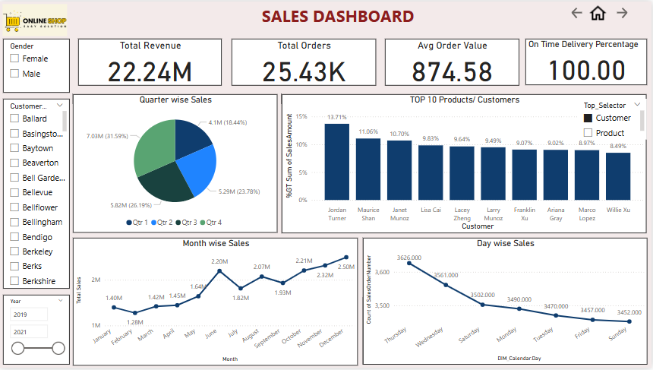

Slide 21
SALES INSIGHTS & RECOMMENDATIONS
INSIGHTS:
Year starts with low sales with February being the lowest( 1.3 M). Whereas sales Peaked in December with total sales of 2.5 Million
Quarter 4 records the highest sales with 31.59%
Jordan Turner alone contributes 16K
Analysis shows that there was no delay in delivery
RECOMMENDATIONS:
As Q1 lags behind and shows lowest revenue, we can introduce New Year campaigns or offers to stimulate early-year purchases
Year-end shows high sales indicating strong seasonal buying behavior. Hence, major campaigns can be launched as part of holiday discounts and promotions

Slide 22
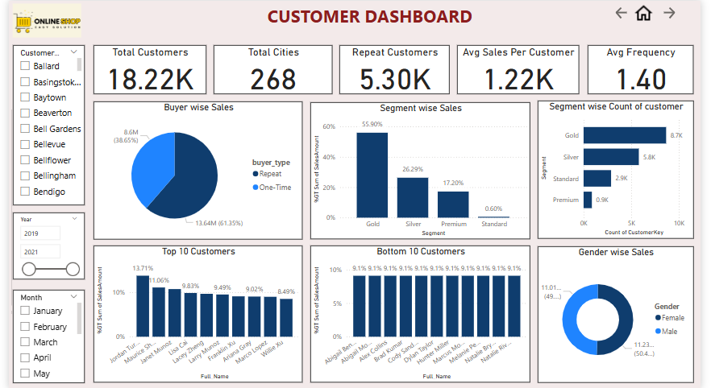

Slide 23
CUSTOMER INSIGHTS & RECOMMENDATIONS
INSIGHTS:
Majority of customers are repeat buyers (≈61%), which signals a strong retention.
Repeat buyers contribute more in terms of sales volume when compared to one-time buyers.
Gold customers contribute to the maximum sales followed by Silver.
Although we only have 0.9K premium customers but yet they contribute 17.20% of sales whereas Standard customers contribute 0.60% even though they are significantly higher than Premium customers
Gender distribution is almost perfectly balanced — no major bias in performance.
RECOMMENDATIONS:
Need to focus on Converting One-Time Buyers to Repeat customers.
Offer upgrades, or premium services tailored to the segment needs. So that we can convert Gold and Silver into premium Segments.
We can see that bottom 10 have the same sales total. We should target them and offer discounts to attract and increase their sales

Slide 24
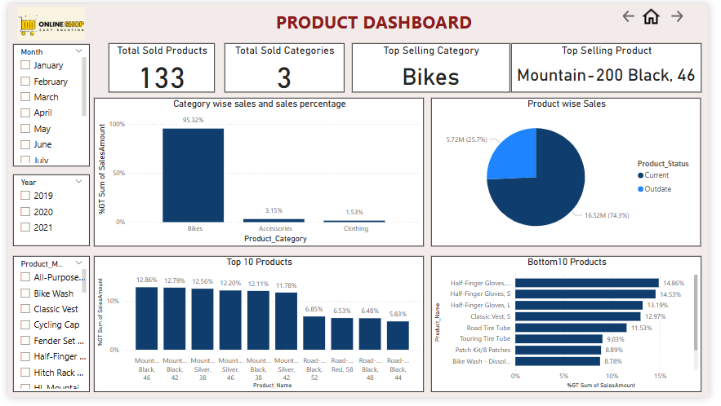

Slide 25
PRODUCT INSIGHTS & RECOMMENDATIONS
INSIGHTS:
The Bikes category dominates sales, contributing 95.32% of the total revenue.
Among the five product categories (Accessories, Bikes, Clothing, Components, and Others), only three categories are generating sales, with Accessories and Clothing contributing minimally.
Despite being outdated, some products still account for a significant 25.7% of total sales, indicating ongoing demand or customer loyalty.
Mountain-200 Black, 46 is the highest selling product
RECOMMENDATIONS:
Launch targeted discounts and marketing campaigns to boost sales in the underperforming or non-selling categories, such as Accessories and Clothing.
Increase sales of current, relevant products by emphasizing their unique benefits and features in promotional materials.
Gradually phase out outdated products to streamline inventory, while monitoring customer response to avoid losing loyal buyers.
Make the least sold products more appealing through attractive offers, or value-added promotions to stimulate interest and demand.
Consider conducting customer surveys or feedback sessions to understand preferences and barriers related to the low-performing categories, enabling more tailored marketing strategies.

Slide 26
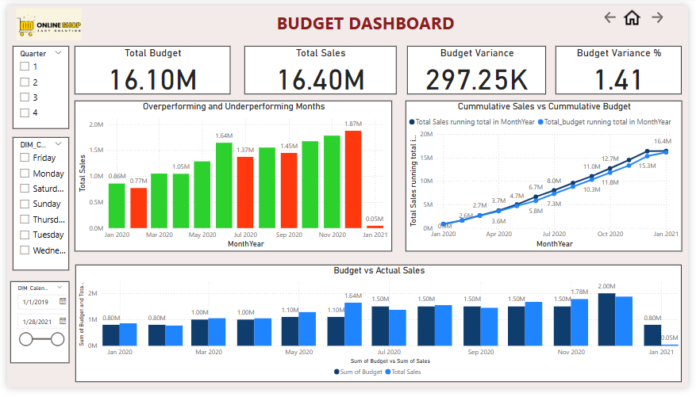

Slide 27
BUDGET INSIGHTS & RECOMMENDATIONS
INSIGHTS:
Over performing Months are January, March, April, May, June, August, October, November in 2020
Under performing Months are February, July, September, December – 2020 and January – 2021. This shows Inconsistent performance across the year.
Cumulative Budget consistently outpaces Cumulative Sales
RECOMMENDATIONS:
As very few months have made sales way above the budget with mostly being below or barely touching the budget we can re-evaluate budget allocation
Invest in targeted campaigns, upsell/cross-sell offers in the months which are below the budget.
As the budget is currently at overall level, it can be refined by adding budget product, category or region wise. This can help analyze which specific areas are over or underperforming and refine efforts accordingly.

Slide 28
THANK YOU

